Slide 1

Call Centre Management System
Shravandeep Yadav 22204003
Shreyas Pawar 22204002
Sarvesh Takle 22204006
Anurag Sawant 22204016
Project Guide
Prof. Neha Deshmukh

Slide 2
Contents
Introduction
Objectives
Scope
Features / Functionality
Project Outcomes
Technology Stack
Block Diagram
Conclusion

Slide 3
1. Introduction
Problem Identified :
The existing system is manual and limited.
Sharing data is not possible if it’s in paper or disk drives.
Manual system provides less security and some data may be lost due to mismanagement.
Searching for particular information takes a lot of time.
Maintaining call records and employee rosters manually is a tedious job.

Slide 4
1. Introduction
Solution Proposed :
The development of this new system contains the following activities, which try to automate the entire process keeping in the view of database integration approach.
The application has a rich user interface and is user-friendly.
The system makes project management easier and more flexible.
User information is stored in a centralized database, providing good security.
Only registered users can access the application.
The automated system provides reliable services with improved speed and accuracy.

Slide 5
2. Objectives
1. To streamline and optimize call center operations.
2. To provide a centralized platform for managing incoming and outgoing queries.
3. To track employee progress and view all the calls made.
4. To enhance the efficiency of call center operations and improve customer experience.
5. To increase systems overall productivity.

Slide 6
3. Scope
Can manage various business operations and communications.
Can handles customer service and technical support, agent training and employee engagement, and workforce management and agent scheduling.
Can manage a large set of employees and view their statistics.
Can be implemented in corporates and companies that provide services and products.
Can be used by small industries or shops to manage the customer queries and the employees addressing to that queries .

Slide 7
4. Feature /Functionality
Login: To access and keep the track of all employees the admin has its own login page, same login authentication is for the employee to meet their daily targets from any device.
Admin dashboard: After successful login the admin can perform crud operations like create, delete, manage, update, employee, and check their stats like calls made and rating.
Employee Dashboard: Employee can keep a track of their stats like call logs, ratings and total calls. Employee can work on solving the active tickets and update them as the get solved. Can get access to customer info where they can find the notes or queries written regarding that customer.
Connection between User and Employee: When a customer sends a query through the customer interaction page, the employee receives it as a token and assigns a unique token number to the customer. Once the query is resolved, the customer is notified via email that their problem has been solved.

Slide 8
5. Outcome of Project
User can Login: The user logging in can be an admin or an employee.
Admin authorities:
a. Admin can observe and keep a track of the employee by checking the ratings provided by the customers and the calls made.
b. Admin can create, update and manage all the employees, and provide customer information’s that can be used by employee and can be considered as a target to achieve.
Employee Authorities:
a. Employee can observe their call logs, active tickets, resolved tickets and work according to them which enhances the employee productivity.
b. Gets customer info required to solve the queries regarding that customer.

Slide 9
6. Technology Stack
Fronted HTML, CSS, JavaScript
Backend: Python
Database Used: NoSQL
For session handling JWT
Software Used: VS Code,
Framework Used: Flask

Slide 10
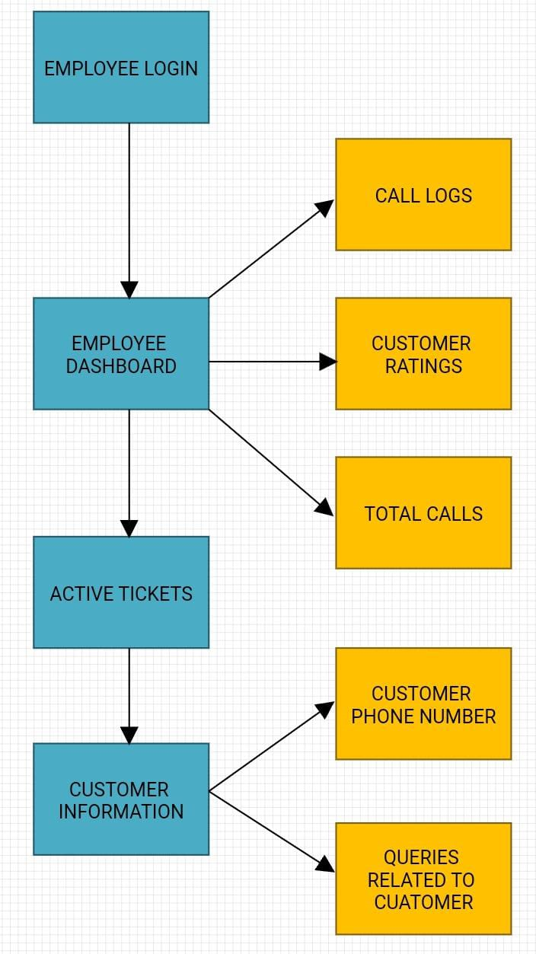
6. Block Diagrams
Admin:

Slide 11
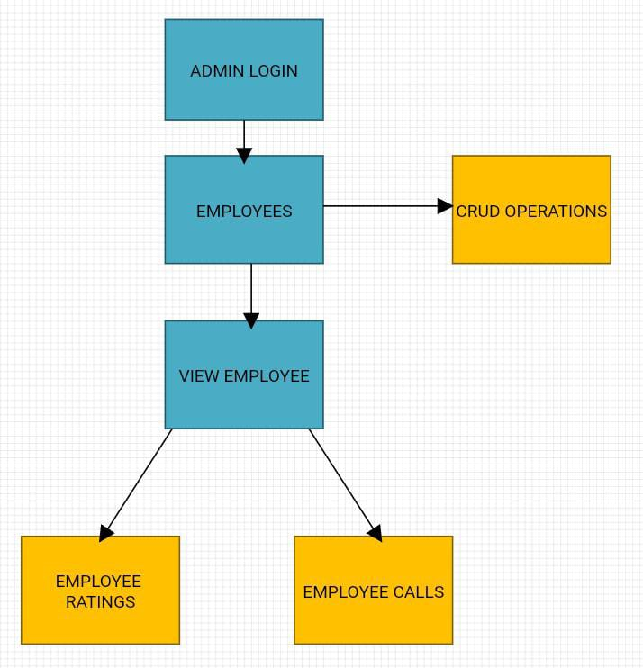
6. Block Diagrams
Employee:

Slide 12
6. Conclusion:
In conclusion, a well-designed call center management software can significantly improve the efficiency and effectiveness of call center operations. It can streamline call center operations, provide real-time insights into agent performance, and enhance the overall customer experience.

Slide 13
Thank You...!!

